Slide 1
The republic of...
Chile
Shelby Nix

Slide 2
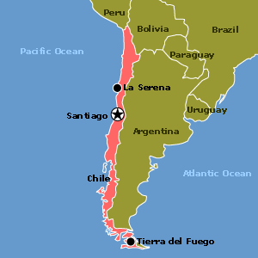
Map of Chile and the Capital~
The capital of Chile is...
Santiago

Slide 3
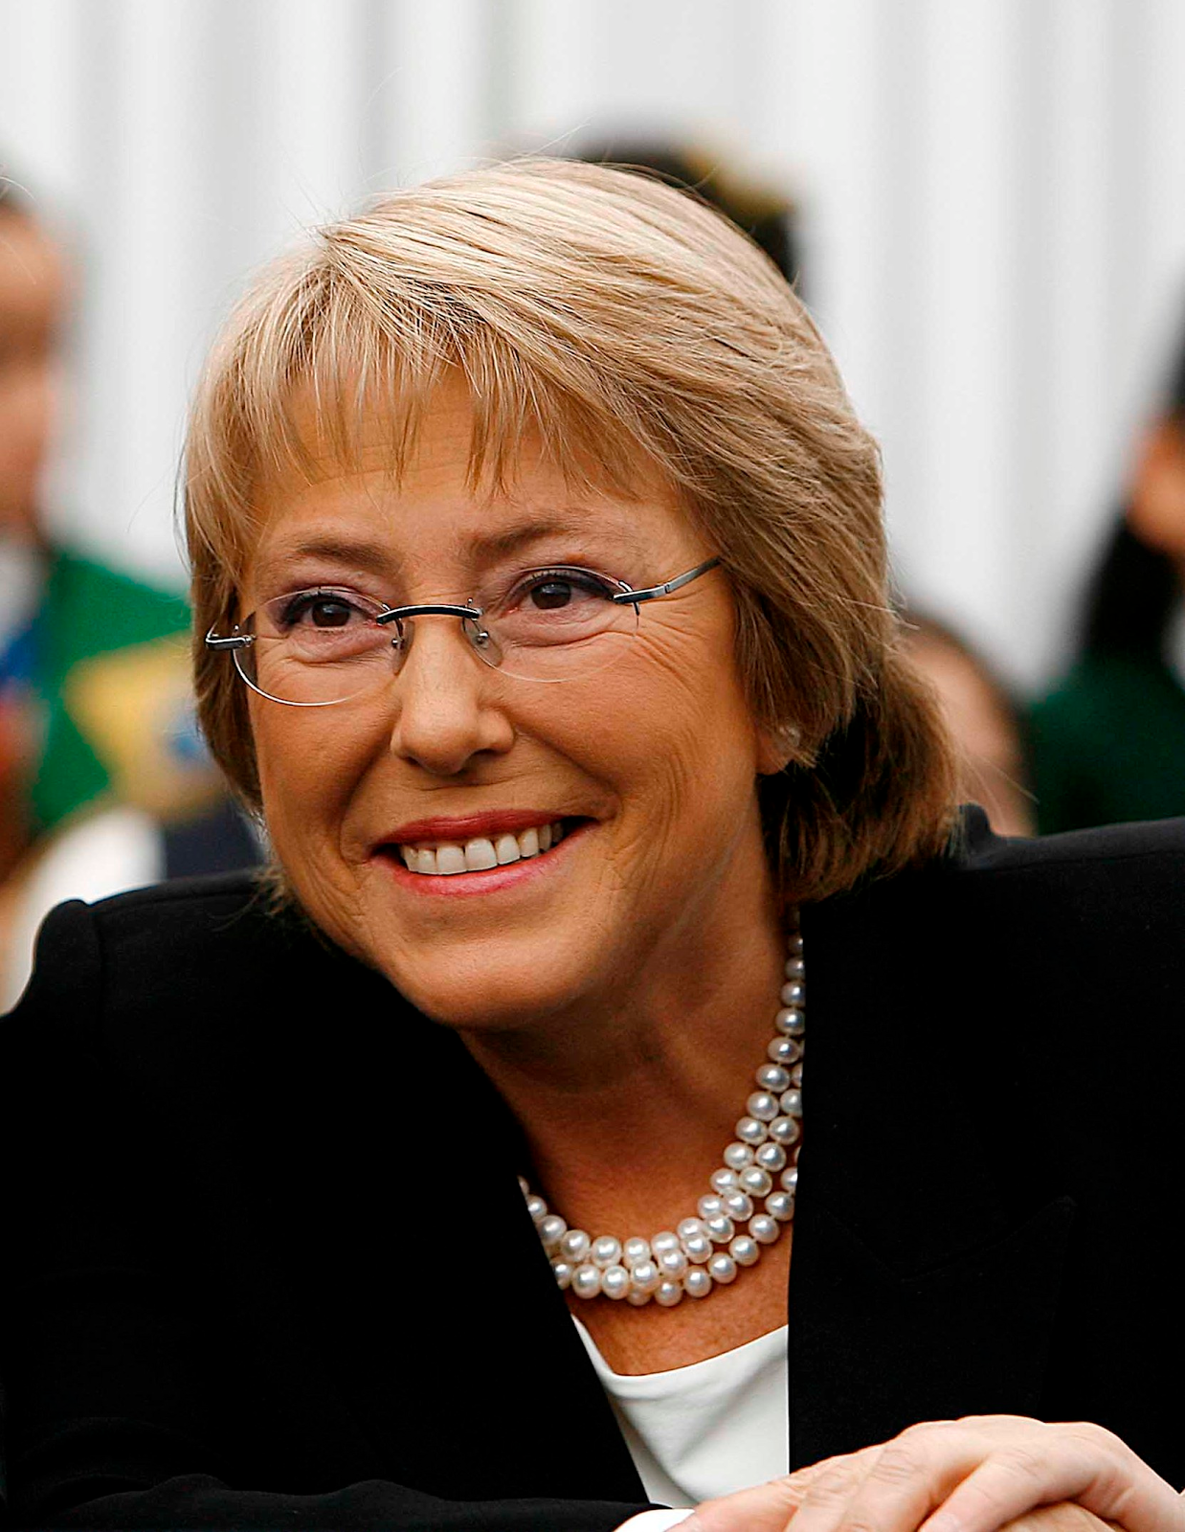
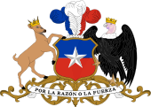
Government of Chile and Leader~
Unitary Presidential Constitutional Republic
The leader of Chile is Michelle Bachelet

Slide 4
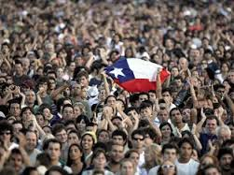
Demographics~
Population: 17.62 million
Races:
White and
White-Amerindian 95%
Amerindian 3%
other 2%
Religions:
86%-Roman Catholic
11%-Protestant
3%-Other

Slide 5
Languages
Spanish 89%
Other 11%

Slide 6
Currency- Peso
$1.00 in the United States would be $588.50 in Chile.
Average Income- $46,873 in Pesos

Slide 7
Industries
Exports
Imports
Some industries of Chile include:
forestry
wine
copper,iron,steel
wood and wood products
cement textiles
Some exports of Chile include:
fish
fruits and frozen juices
wine
copper
farming materials
lumber
industrial inorganic chemicals
Some imports of Chile include:
fuel oil
computers
civilian aircraft and parts
petroleum products
computer accessories
telecom equipment
industrial machinery

Slide 8
Corn Pie (pastel de choclo)
500 grams fresh corn kernels
1 handful fresh basil leaves
1 teaspoon salt
meat
500 grams chopped meat of your choice
1 tablespoon vegetable oil
2 medium white onions
1 tablespoon cumin seeds
1 tablespoon paprika or chilli
2 large hard-boiled eggs
2 tablespoons raisins
1 handful black olives
3 tablespoons granulated sugar
The basic idea is chopped corn with salt and basil leaves added. The consistency is like that of what you use to make sweetcorn chowder. If the sweetcorn were not so tender, you may use some full fat milk to get the consistency right.
On a pan with vegetable oil, sauté small onion cubes, chopped meat (I know some who prefer chicken thighs keeping the bone), cumin seeds, salt and ground paprika (some people use ground chilli). This should taste similar to chilli con carne but more oniony (if there's such a word). Once the meat is cooked and the onion has become translucent, put this in individual terracotta dishes or in a large, not so shallow, non-stick tray if you prefer.
Then slice up a couple of boiled eggs and lay the slices upon the meet and onions, together with some black olives and raisins. Pour the corn paste as a third layer, and off to the oven for 15 min.
Now the final step: the gratin, which is just some white sugar on top and back to the oven to get grilled. The best option to eat with is tomato salad with raw onion and a sprinkling of chopped basil leaves or coriander.

Slide 9
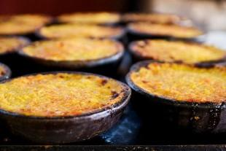
Chilean Corn Pie

Slide 10
Interesting Facts
Nicole Polizzi “Snooki” was born in Chile.
The national animal of Chile is the “Huemul” or the South Andean Deer.

Slide 11
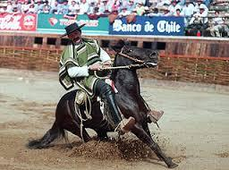
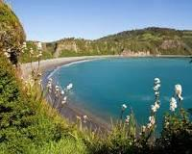
Interesting Facts
Chiloé Island, also known
as Greater Island of Chiloé is the largest island of the Chiloé Archipelago off the
coast of
Chile, in
the Pacific
Ocean.
The national sport of Chile is rodeo.

Slide 12
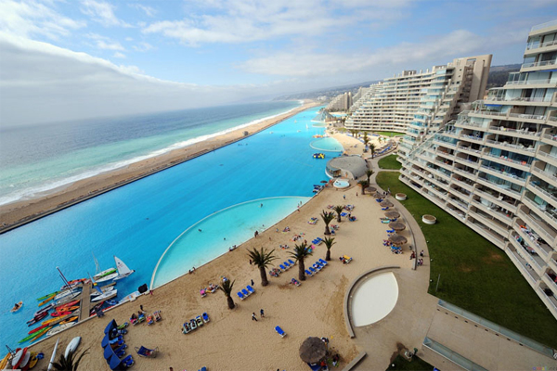
Interesting Facts
The world’s biggest swimming pool is in Chile.

Slide 13
Cites~
http://en.wikipedia.org/wiki/Politics_of_Chile http://en.wikipedia.org/wiki/President_of_Chile
http://www.infoplease.com/ipa/A0855617.html
http://en.wikipedia.org/wiki/Religion_in_Chile
http://www.kwintessential.co.uk/resources/global-etiquette/chile.html
http://www.flagmakers.co.uk/wp-content/uploads/flags/country/Chile-National-Flag.jpg
https://data.un.org/_Images/Maps/Chile.gif
http://upload.wikimedia.org/wikipedia/commons/thumb/5/5b/Coat_of_arms_of_Chile.svg/170px-Coat_of_arms_of_Chile.svg.png
http://www.x-rates.com/calculator/?from=USD&to=CLP
http://www.economywatch.com/world_economy/chile/export-import.html
https://www.google.com/search?q=rodeo+chile&biw=1188&bih=596&source=lnms&sa=X&ei=y3lAVOHvM4eUgwTOv4GgBA&ved=0CAUQ_AUoAA&dpr=1.15#q=chiloe+island&stick=H4sIAAAAAAAAAGOovnz8BQMDQzsHsxCHfq6-gWGBYZkSJ5hVVGBapqWQnWyln5OfnFiSmZ-nn5xfmldSVGmVWFJSlJgMEip-xOjNLfDyxz1hKadJa05eY7ThIqhFSIKLzTWvJLOkUoiPi0cKbq8GA49l8MpzsddLxJaLm1kHZWam6Ec_PAcAMJSrPqQAAAA
http://www.jeeppatagoniaexpeditions.com/blog/top-10-things-you-didnt-know-about-chile-facts-about-chile/

